Slide 1
第一組

Slide 2
Question 7
V. Pan has discovered a way of multiplying 68 X 68 matrices using 132,464 multiplications, a way of multiplying 70 X 70 matrices using 143,640 multiplications, and a way of multiplying 72 X 72 matrices using 155,424 multiplications. Which method yields the best asymptotic running time when used in a divide-and- conquer matrix-multiplication algorithm? How does it compare to Strassen’s algorithm?

Slide 3
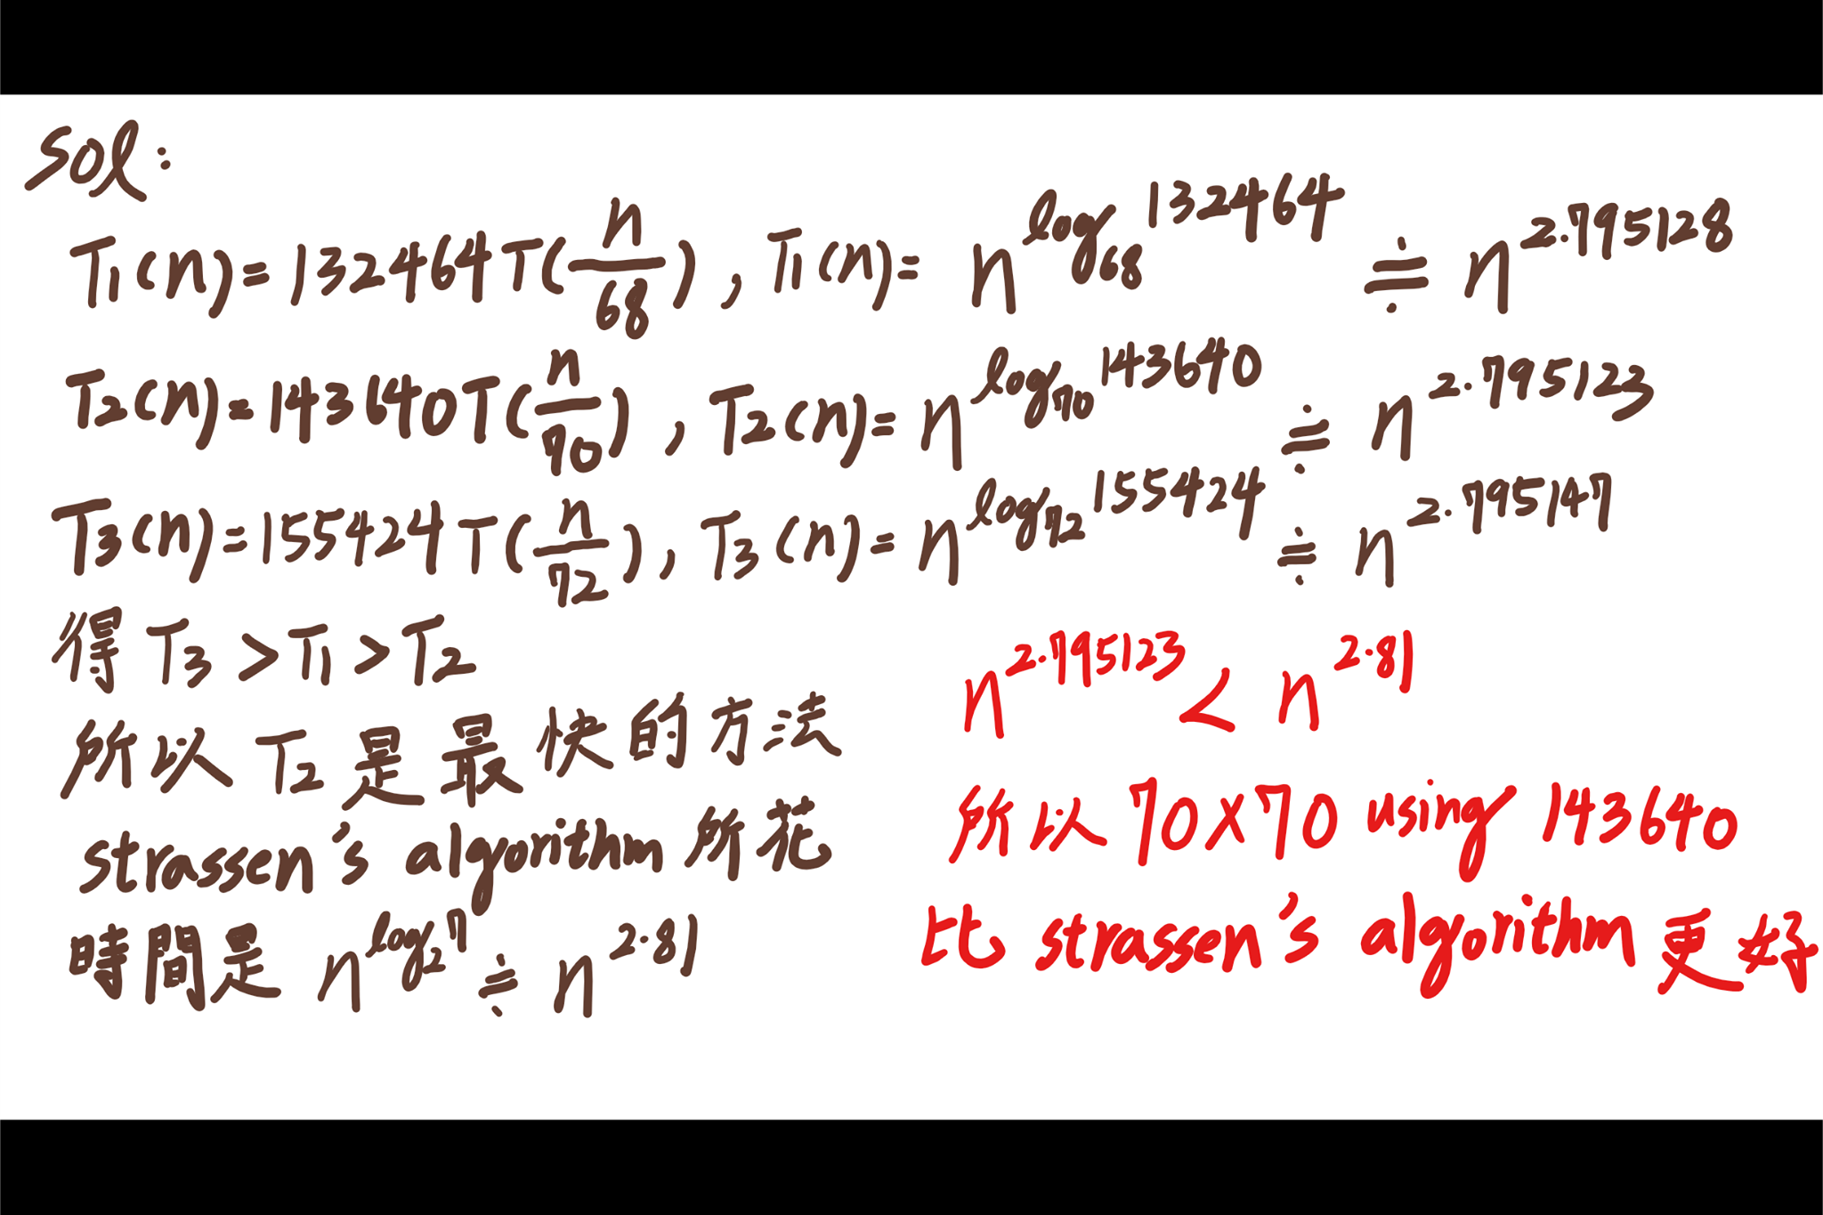
Slove:

Slide 4
Thanks~~~

